Slide 1
QUIZ ….only to Recap
How many terminals and regions are in BJT
How many junctions in BJT
BJT is asymmetric or symmetric device
How many types of BJT transistor are there
What are modes of operations of BJT
Why is emitter heavily doped while base is lightly doped
How does charges flow from emitter to collector
In which type of BJT current flows out of the base

Slide 2
Affect of Base-emitter area on current

Slide 3
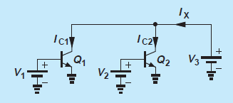
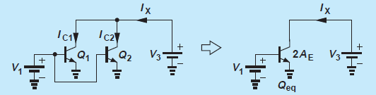
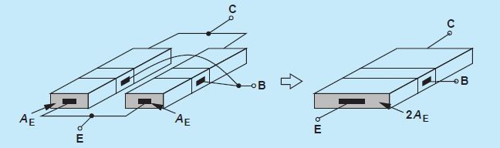
Example
Determine the current Ix, if Q1 and Q2 are identical and operate in active mode and V1=V2

Slide 4
Solution
Since
We have
The result can also be viewed as collector current of a single transistor having an emitter area of 2x A. In fact, redrawing the circuit and noting that Q1 and Q2, experiences identical voltages at their respective terminals, we say the two transistors are “parallel”, operating as a single transistor with twice the emitter area of each.

Slide 5
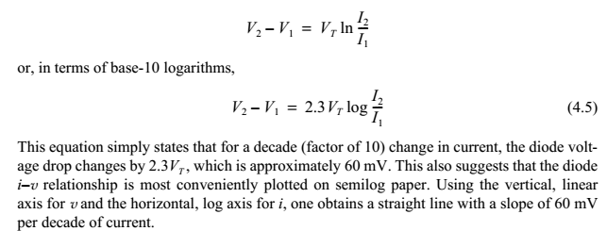
Example:2
If we double Area of a transistor and decrease its Base-Emitter voltage by 60 mv . What is the change in collector current
Because of the double Area
=0.1 , decade decrease in current
So almost 5 times reduction in collector current

Slide 6
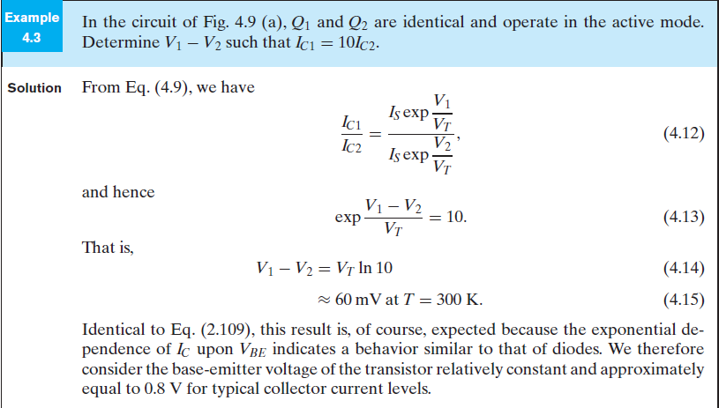
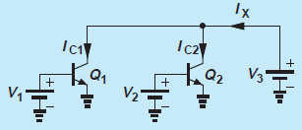
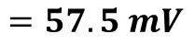
$$=57.5 mV$$

Slide 7
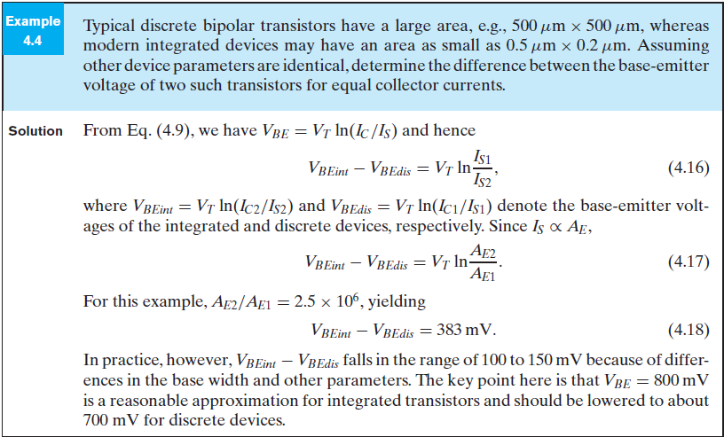
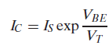
Since
or

Slide 8
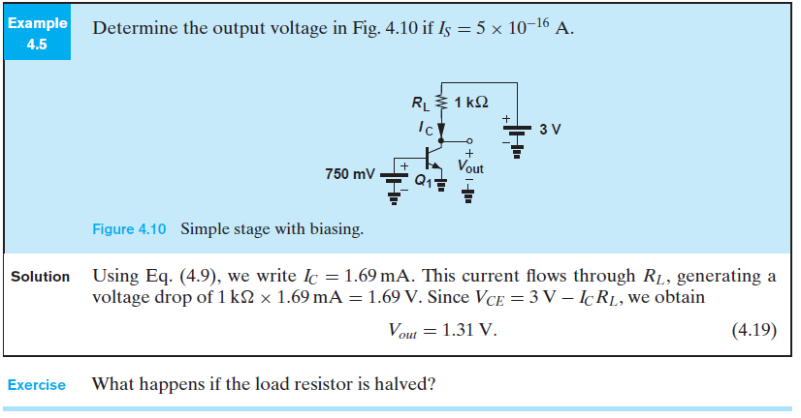
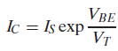
Determine output voltage if
This current flows through RL , generating a voltage drop of 1.69 V

Slide 9
Example: A transistor has a collector current of 1 mA and What is the value of VBE
Therefore VBE =778 mV
Now if β= 50,
This relationship you will understand in subsequent slides

Slide 10
Current Flows
Basically Three types of currents
Collector current
Base Current
Emitter Current

Slide 11
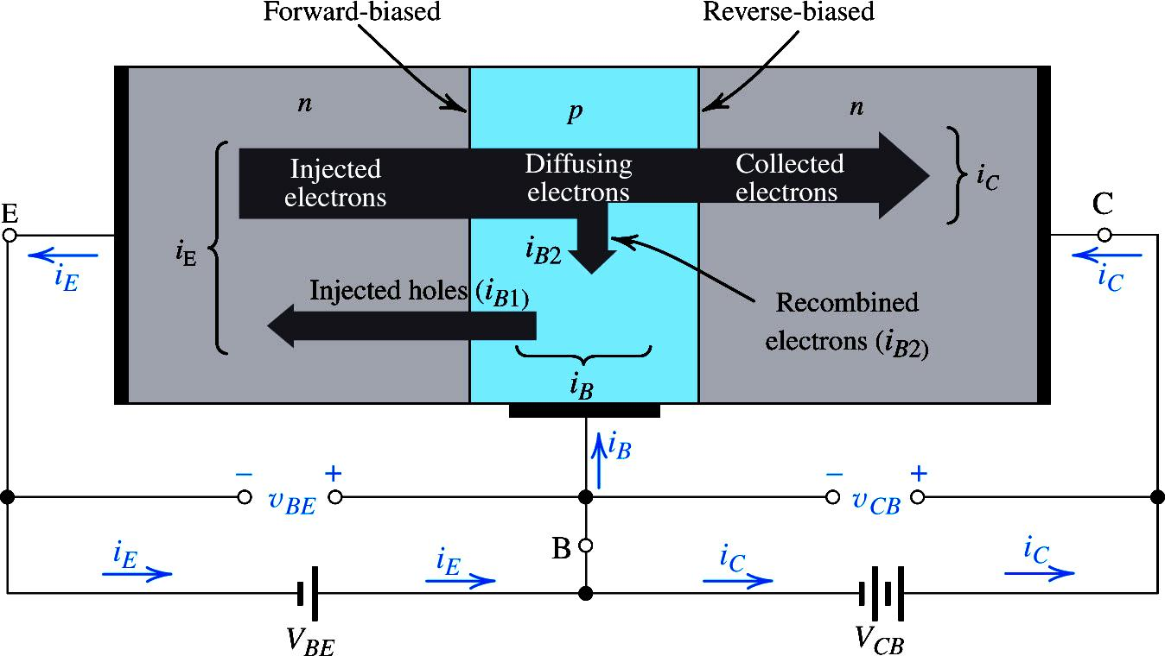
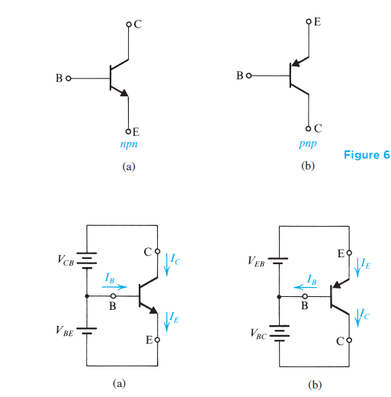
DC Analysis of BJTs
Transistor Currents:
I_{E} = I_{C} + I_{B}
alpha (α_{DC})
I_{C} = α_{DC}I_{E}
beta (β_{DC})
I_{C} = β_{DC}I_{B}
β_{DC} typically has a value between 20 and 200

Slide 12
NPN Transistor: Collector Current

Slide 13
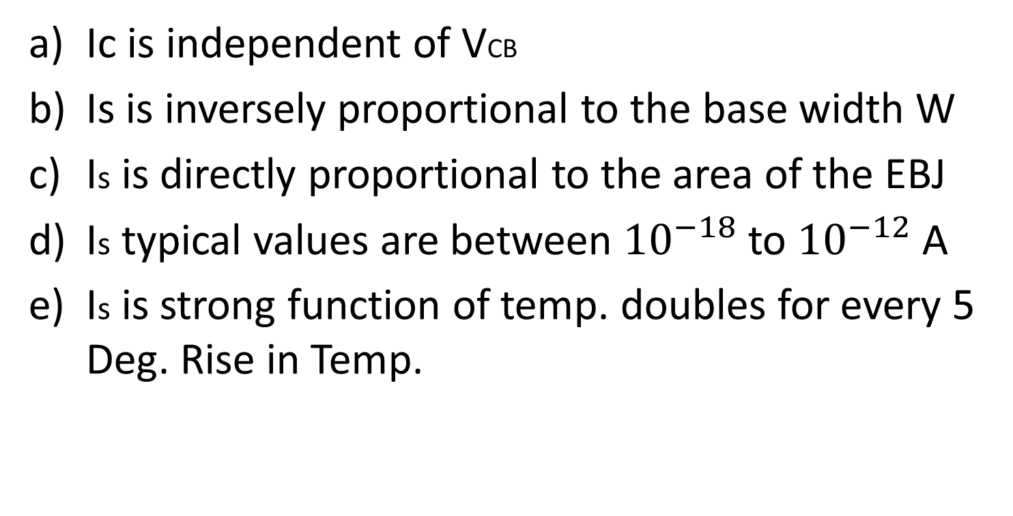
Important observations
Ic is independent of VCB
Is is inversely proportional to the base width W
Is is directly proportional to the area of the EBJ
Is typical values are between ${10}^{−18}$ to ${10}^{−12}$ A
Is is strong function of temp. doubles for every 5 Deg. Rise in Temp.

Slide 14
NPN Transistor: Base Current
Note it is proportional to not equal to

Slide 15
NPN Transistor: Base Current
The parameter β is called the common-emitter current gain
β is in the range 50 to 200, but it can be as high as 1000 for special devices

Slide 16
NPN Transistor: Emitter Current
α is called the common-base current gain.

Slide 17
Recapitulation
Basically, the forward-bias voltage VBE causes an exponentially related current iC to flow in the collector terminal.
The collector current Ic is independent of the value of the collector voltage as long as the collector–base junction remains reverse biased; that is, vCB ≥ 0.
Thus in the active mode the collector terminal behaves as an ideal constant-current source where the value of the current is determined by vBE. The base current iB is a factor 1/β of the collector current, and the emitter current is equal to the sum of the collector and base currents.
Since iB is much smaller than iC (i.e., β>> 1), iE = iC. More precisely, the collector current is a fraction α of the emitter current, with α smaller than, but close to, unity.

Slide 18
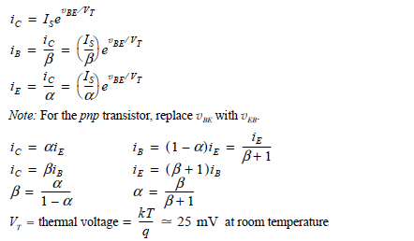
Summary of the BJT current – voltage Relationship in Active Mode

Slide 23
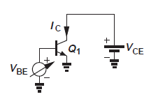
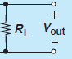
What is wrong here?
And desired
I wanted to have an output of 100mV ; it implies that I must have a resistance equal to

Slide 24
How can I fix it
2.48mA
1.7mA
760mv
10 mv
750mv

Slide 25
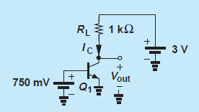
Biasing the transistor

Slide 26
Lecture No 6 BJT

Slide 27
DC Analysis
First question to be asked, In which mode is transistor operating?
A quick check of the terminal voltages will indicate whether the transistor is cut off or conducting
If conducting , we have to determine whether it is operating in the active mode or in saturation.
Using following step by step procedure we can determine the terminal voltages

Slide 28
DC Analysis
Assume that the transistor is operating in Active mode
Check for consistency of the results with the FB conditions, the Vbe FB, Vcb RB more than -0.4 for NPN and lower than 0.4 for PNP; If yes the task is complete but if no then
Assume saturation mode:
Proceed to determine currents and voltages, then check for consistency of the result
Here important would be to calculate Ic/Ib ratio and verify that it is lower then the transistor beta

Slide 29
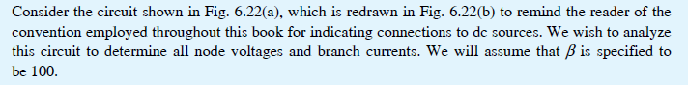
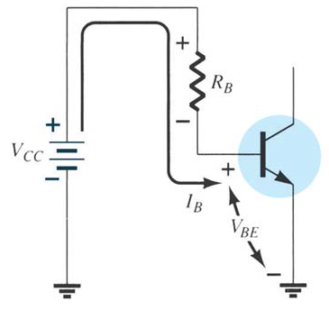
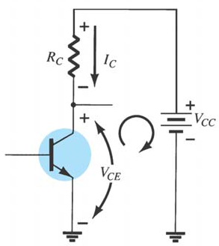
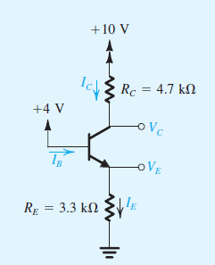
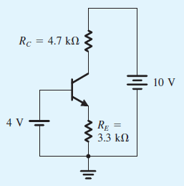
We can see basically two loops BE and CE

Slide 30
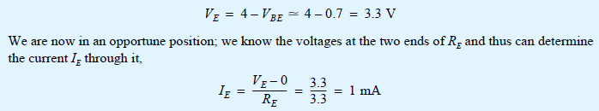
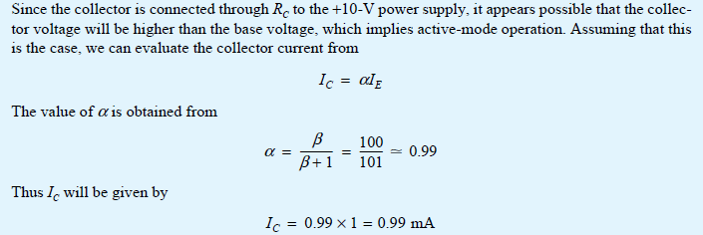
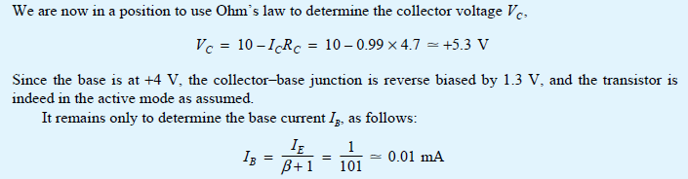

Slide 31
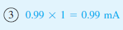
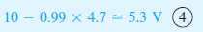
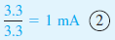
It is recommended to carry out the analysis directly on the circuit diagram. This way time can be reduce, if the steps are followed in proper sequence

Slide 32
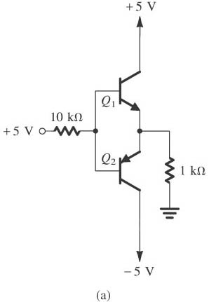
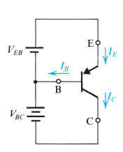
DC analysis BJT …….Cont..
Evaluate the voltages at all nodes and the currents through all branches in the circuit
By examining the circuit, we conclude that the two transistors Q1 and Q2 cannot be simultaneously conducting
But Why?
Now Assume Q2 is on then
current will flow from ground through the 1-kΩ resistor into the emitter of Q2. Thus the base of Q2 will be at a negative voltage, and
base current will be flowing out of the base through the 10-kΩ resistor and into the +5-V supply, which is not possible
In PNP the current flows out of Base

Slide 33
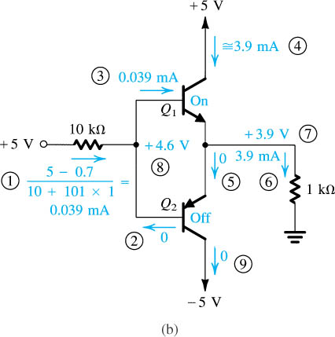
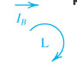
0
0
The BE loop have two currents , The relationship is (between base and emitter with 1+β)

Slide 34
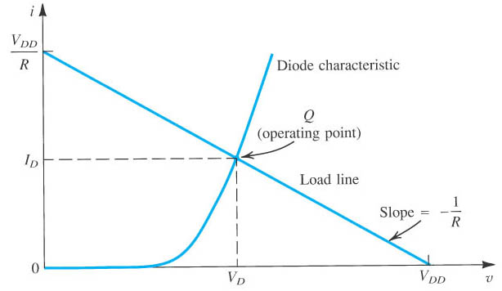
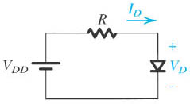
Graphical Analysis of Exponential Model
Recall DIODE
Graphical analysis is performed by plotting the two Equations on the i–v plane. The solution can then be obtained as the coordinates of the point of intersection of the two graphs

Slide 35
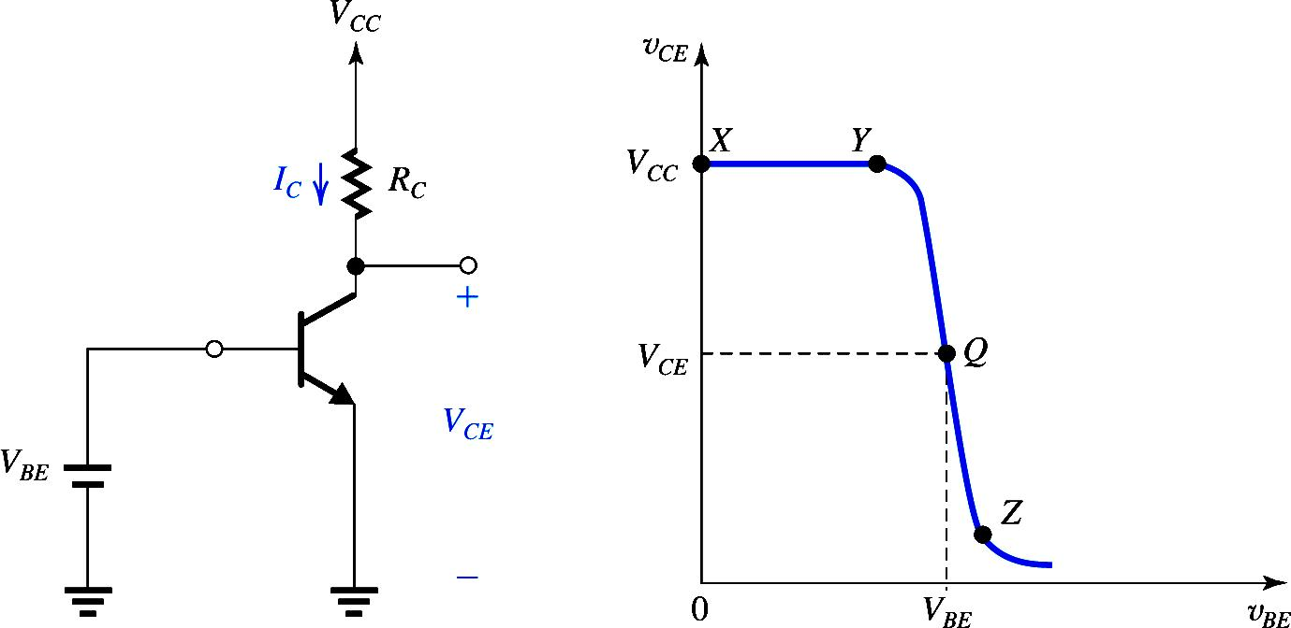
Applying same concept to Basic BJT Circuit
Input
Output

Slide 36
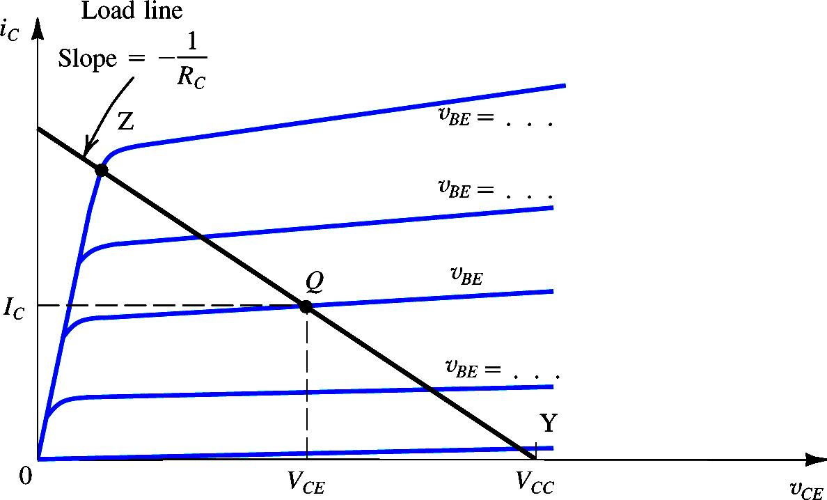
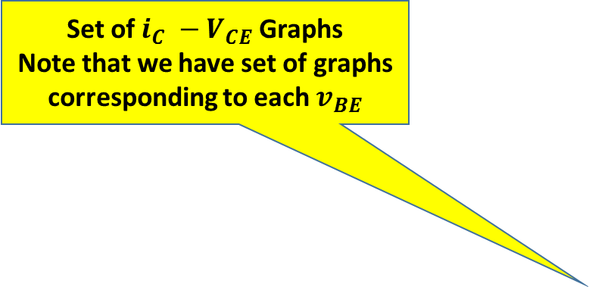
Set of $i_{C} −V_{CE}$ Graphs
Note that we have set of graphs corresponding to each $v_{BE}$
Graphical Analysis: Locating Bias Point
Determine Load Line
Which point on Load line
Point Y : v_{BE} = 0.5
Point Z : BJT leave the active mode

Slide 37
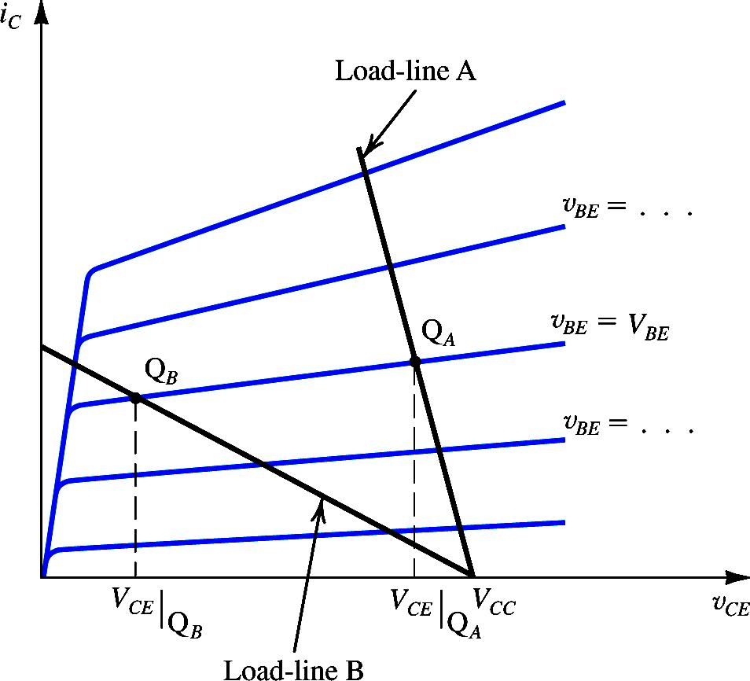
Graphical Analysis: Locating Bias Point
Bias point determined by the value of V_{BE} and the load resistance R_{C}
Two important considerations in deciding on the location of Q point:
Gain
Allowable signal swing at the output
Gain can be increased by locating the Q point closer to point Z (saturation)
Z
More gain if small

Slide 38
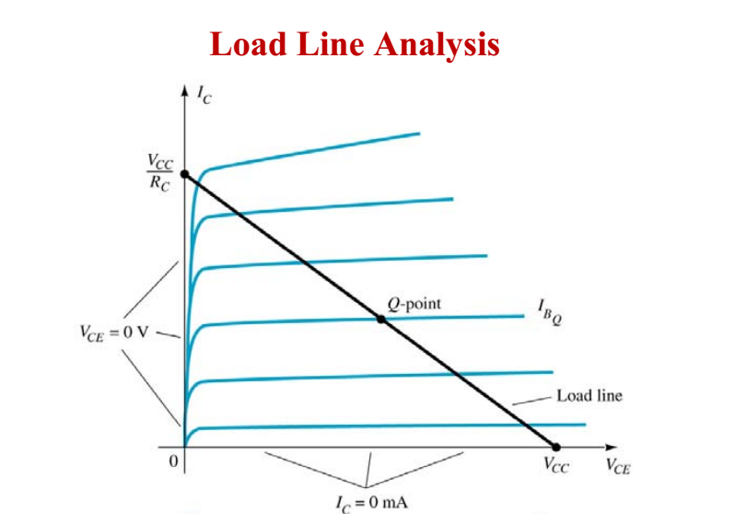
End point 1: saturation
End point 2: Cut off

Slide 39
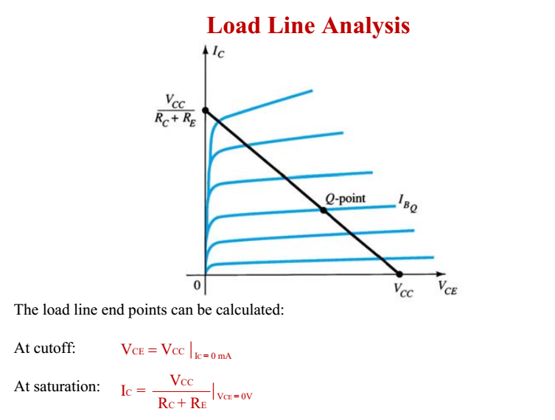

Slide 40
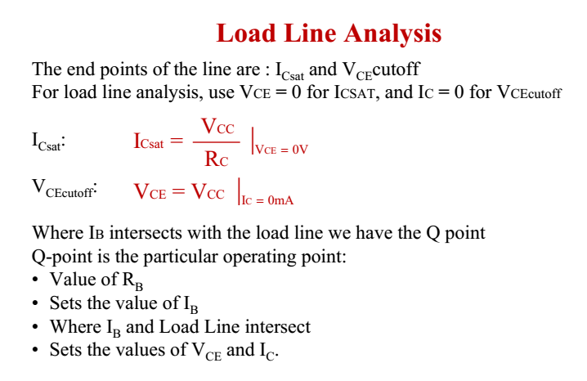

Slide 41
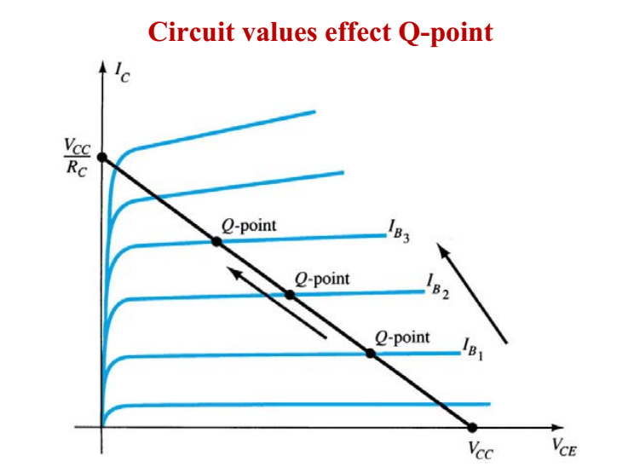
Note :As we increase IB The Q point moves upward, that is closer to saturation region

Slide 42
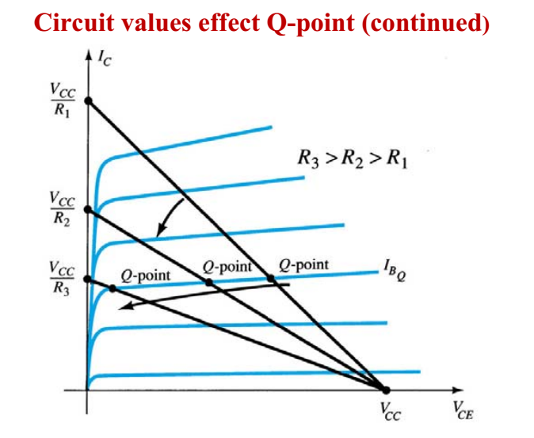
With increasing R the slope decreases

Slide 43
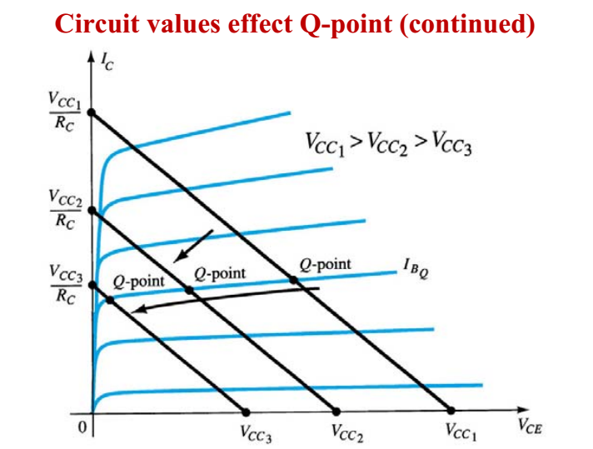
What is observation Here?

Slide 44
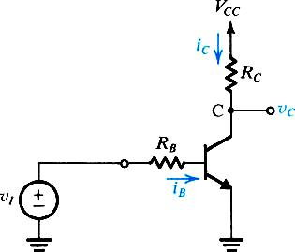
BJT as a Switch
I
II
III

Slide 47
Lets see what happens if we increase/decrease base voltage

Slide 48
Why not in active mode??????

Slide 49
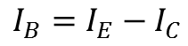
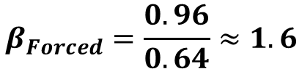
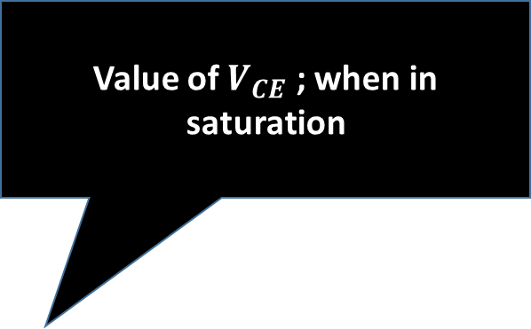
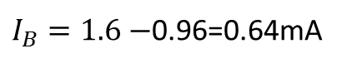
Value of $V_{CE}$ ; when in saturation
$$I_{B}=I_{E}−I_{C}$$
$I_{B}=1.6−$0.96=0.64mA
We didn’t use $\frac{I_{C}}{I_{B}}=β$
$$β_{Forced}=\frac{0.96}{0.64}≈1.6$$

Slide 51
Here base at zero , does not mean in cutoff. Since it is a pnp transistor

Slide 53




$$I_{E−max}=\frac{V_{CC}−V_{E}}{1000}=\frac{5−0.7}{1000}=4.3mA$$
$$I_{C−max}=\frac{V_{EC}−V_{EE}}{1000}=\frac{0.3−(−5)}{10000}=0.47mA$$
$$I_{B}=I_{E}−I_{C}=4.3−0.47=3.83mA$$
$$I_{c}=30×3.87=116mA$$
All these values indicates that not in active mode
$\frac{I_{C}}{I_{B}}=β=\frac{0.47}{3.83}=0.1$2

Slide 54




$$V_{EB}=V_{E}−V_{B}$$
$$V_{EC}=V_{E}−V_{C}$$
$${−V}_{C}=V_{EC}−V_{E}$$
$$V_{C}=V_{E}−V_{EC}$$
All currents are now with respect to. VB, using $I_{E}=I_{C}+I_{B}$

Slide 57
Short Break
LEC-6

Slide 58
Sequence & Topics to be covered
Applying the BJT in Amplifier Design
Obtaining a Voltage Amplifier
The Voltage Transfer Characteristic (VTC)
Biasing the BJT to Obtain Linear Amplification
The Small-Signal Voltage Gain
Locating the Bias Point Q
Small-Signal Operation and Models
The Base Current and the Input Resistance at the Base
The Emitter Current and the Input Resistance at the Emitter
Voltage Gain
Separating the Signal and the DC Quantities
Application of the Small-Signal Equivalent Circuits
Augmenting the Small-Signal Models to Account for the Early Effect

Slide 59








Further Example on DC Analysis
Depending upon information available we start with either of the Loop
We try to find
$$I_{C}$$
$$I_{B}$$
$$I_{B}$$
$$V_{C}$$
$$V_{E}$$
$$V_{B}$$
These will help us in calculating mode of operation and small signal parameters

Slide 63


First Part is same as in 6.10, except
$$V_{C1}$$
Old vc=8.6
$$I_{C1}=I_{B2}+I_{RC1}$$

Slide 65

$$I_{C1}=I_{B2}+I_{RC1}$$

Slide 68
BJT as Amplifier

Slide 69
BJT as Amplifier
when operated in the active mode, the BJT functions as a voltage-controlled current source: the base–emitter voltage controls the collector current
Although the control relationship is nonlinear (exponential), we will shortly devise a method for obtaining almost-linear amplification from this fundamentally nonlinear device.

Slide 70
BJT as Amplifier
A voltage-controlled current source can serve as a transconductance amplifier, that is, an amplifier whose input signal is a voltage and whose output signal is a current
A simple way to convert a transconductance amplifier to a voltage amplifier is to pass the output current through a resistor and take the voltage across the resistor as the output.

Slide 71
The Voltage Transfer Characteristic (VTC)
A very useful tool that yields great insight into the operation of an amplifier circuit is its voltage transfer characteristic (VTC). This is simply a plot of the output voltage versus the input voltage.( Graph)

Slide 72



v_{O}
Negative Slope

Slide 73
Note that the output voltage is taken between the collector and ground, rather than simply across Rc. This is done because of the need to maintain a ground reference throughout the circuit. The output voltage is given by
The out put is 180 Deg. Phase shifted
(x-y) For Cutoff mode and
(y-Z) Active mode
Saturation mode
For greater than that at point Z,
the transistor operates in the saturation region and decreases very slowly

Slide 74

The VTC indicates that the segment of greatest slope (and hence potentially the largest amplifier gain) is that labeled YZ, which corresponds to operation in the active mode. An expression for the segment YZ can be obtained by
This is obviously a nonlinear relationship.
linear (or almost-linear) amplification can be obtained by using the technique of biasing the BJT.

Slide 75
Biasing the BJT to Obtain Linear Amplification
Biasing enables us to obtain almost-linear amplification from the BJT.
A dc voltage is selected to obtain operation at a point Q on the segment YZ of the VTC.
observe that the coordinates of Q are the dc voltages and which are related by

Slide 76
Biasing BJT for Linear Amplification

Slide 77
Biasing BJT for Linear Amplification

Slide 78
Biasing BJT for Linear Amplification

Slide 79

Next the signal to be amplified a function of time t is superimposed on the bias voltage . Thus the total instantaneous value of becomes

Slide 80

The Small-Signal Voltage Gain

Slide 81
The Small-Signal Voltage Gain

Slide 82
We make the following observations on this expression for the voltage gain:
The gain is negative, which signifies that the amplifier is inverting; that is, there is a 180 phase shift between the input and the output
2. The gain is proportional to the collector bias current and to the load resistance

Slide 83
Example 6.13
Consider an amplifier circuit using a BJT having IS = A, a collector resistance RC = 6.8 kΩ, and a power supply VCC = 10 V.
Determine the value of the bias voltage VBE required to operate the transistor at VCE = 3.2 V. What is the corresponding value of IC?
(b) Find the voltage gain Av at this bias point. If an input sine-wave signal of 5-mV peak amplitude is superimposed on VBE, find the amplitude of the output sine-wave signal (assume linear operation).
(c) Find the positive increment in vBE (above VBE) that drives the transistor to the edge of saturation,
where vCE = 0.3 V.
(d) Find the negative increment in vBE that drives the transistor to within 1% of cutoff (i.e., to vCE = 0.99VCC).

Slide 84


Slide 85


Voltage gain X input Voltage= Output voltage

Slide 86


Slide 87
Assignment # 4
Example :6.14 and
Problems: 6.28, 6.29, 6.39
Do not submit

Slide 88
Small-Signal Operation and Models

Slide 89


Small Signal Operation and Models

Slide 90
Transconductance

Slide 91
Transconductance
SS
DC
g_{m} is the
“transconductance”

Slide 92

Transconductance
The signal amplitude should be small enough that operation is restricted to an almost linear segment of the
i_{C}-v_{BE} exponential curve
g_{m} varies with variation of Q point

Slide 93

Base Current and Input Resistance

Slide 94
Emitter Current and Input Resistance

Slide 95
Did we use such eq. before?
Also Do Exercise 6.36 and 6.37 as part of assignment

Slide 96
Voltage Gain

Slide 97
Separating the DC & Signal Quantities
The total DC and Small signal circuit is shown.
The DC analysis yield the currents and voltages based on the relevant equations.
The DC sources do no change their values when the signal is applied.
We can replace DC voltages by short circuits and current sources by open circuits respectively to get the Small Signal Model.

Slide 98

Separating the DC & Signal Quantities
The Small signal circuit is shown.
This circuit is useful only to analyze signal voltages and currents.
This is not an actual amplifier circuit.
This circuit shows all the incremental currents and voltages that occur due to applied small signal at the base.

Slide 99

The Hybrid –π Model of BJT
Ie in terms of base resistance
Ie in terms of emitter resistance

Slide 100

The T-Model of BJT

Slide 101


Small-Signal Models Accounting for the Early Effect
The gain will be reduced, depending upon ro

Slide 102




Example 6.14
Analyze the transistor amplifier shown in the Figure to determine its voltage gain v_{o}/v_{i}.
Assume β = 100.
Solution:
1. Determine the operating point. For this purpose.
assume v_{i} = 0 and obtain the dc circuit.
The dc currents and voltage will be:
Since V_{B} = 0.7 V is less than V_{C} , the transistor is operating in the active mode

Slide 103





2. Determine the small-signal model parameters:
3. Replace V_{BB} and V_{CC} with short circuits.
4. Replace the transistor in the circuit by hybrid-π, equivalent-circuit model
5. Analyze of the equivalent circuit

Slide 104



5. Analyze of the equivalent circuit

Slide 105
Steps for the Small-Signal Equivalent Circuits
Eliminate the signal source and determine the dc operating point of the BJT and in particular the dc collector current IC.
2. Calculate the values of the small-signal model parameters
3. Eliminate the dc sources by replacing each dc voltage source with a short circuit and each dc current source with an open circuit.
4. Replace the BJT with one of its small-signal equivalent circuit models.
5. Analyze the resulting circuit to determine the required quantities (e.g., voltage gain, input resistance.

Slide 106


For DC analysis the signal source is removed

Slide 107


Slide 108
Transconductance
Our study so far shows that the bipolar transistor acts as a voltage-dependent current source, when operating in the forward active region
But how we can quantify the performance of such a device, that is the measure of the goodness of a voltage dependent current source
Recalling the first lecture, the device becomes stronger as K increases, because as K is increased , results in larger output current thus larger output voltage
So we concentrate on the voltage –to-current conversion property of the transistor
If a signal changes the base-emitter voltage of a transistor by a small amount, how much change is produced in the collector current
The strength of the device can be represented by ∆Ic/ ∆Vbe
The ratio ∆Ic/ ∆Vbe approaches dIc/dVbe for very small changes in the limit, is called the “ Transconductance , gm

Slide 109


The above equation reveals that as Ic increase, the transistor becomes a better amplifying device by producing larger collector excursions in response to a given signal level applied between the base and emitter
The transconductance may be expressed in or “siemens” S.
For example if Ic =1 mA, then with Vt =26 mv , we have

Slide 110

If experiences a small perturbation ± ∆ V around then the collector current displays a change of × ∆ V around

Slide 111




While considering the small signal notice the output is across Rc

Slide 112

Performing small signal analysis directly on the circuit

Slide 113


Small signal equivalent model with Early Effect

Slide 114





$$V=I×R$$
$$1/R=g_{m}=\frac{I}{V}$$
$g_{m}=$Trans-conductance
$$A_{v}={− g}_{m}×R_{C}$$
$v_{BE}$- $I_{c}$ Methd
VTC- Method

Slide 115


